Slide 1

School Staff
[coordinators name and title]
[add your school’s black and white GUV logo here. You can find this on the GUV Site Coordinator webpage]

Slide 2

WHAT IS GEAR UP?
Gaining​
Early​
Awareness and ​
Readiness for​
Undergraduate ​
Programs
U.S. Department of Education federal grant program designed to significantly increase the number of students who are prepared to enter and succeed in postsecondary education.

Slide 3
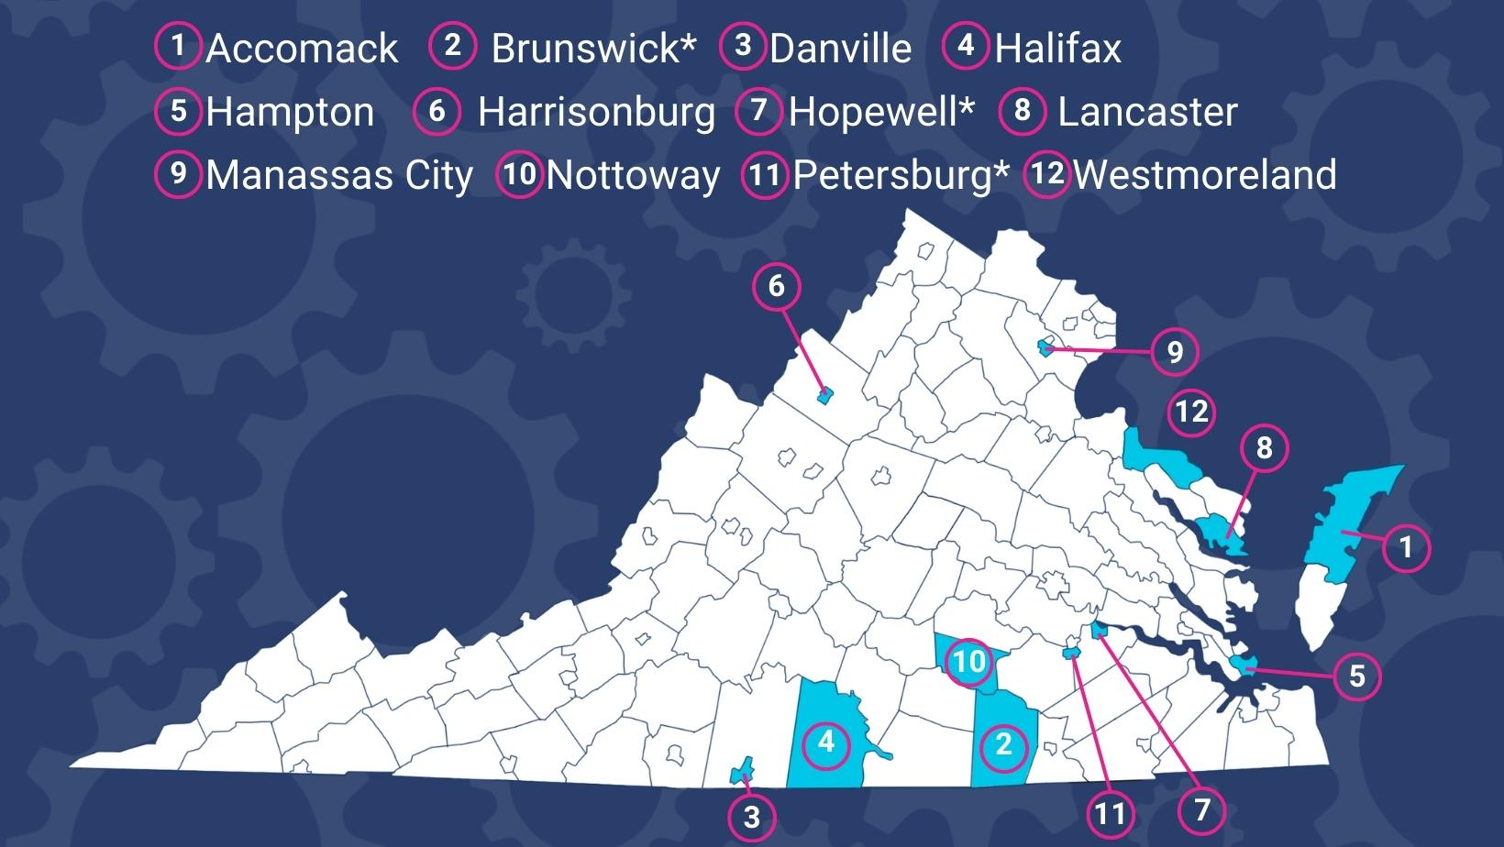
Virginia Awarded GEAR UP Grant​
Administered by The State Council of Higher Education for Virginia (SCHEV) ​
12 partner school divisions​
The grant period is 2021-2028

Slide 4
Virginia Awarded GEAR UP Grant​
County Selection: Based on a variety of indicators of need, including:​
  Educational attainment rates​
  Poverty rates​
  Remediation rates​
Federal requirement: 50% or more of students at target schools must qualify for free or reduced priced lunch

Slide 5
Who GEAR UP Serves:
Students​
Class of 2027 cohort; 11th and ​
12th grade (priority) students​
​
Parents​
Parents and family members​ of GEAR UP students
Educators​
Administrators, counselors and ​
Teachers serving GEAR UP students​
​
Community​
Communities surrounding GEAR ​
UP schools

Slide 6
Who GEAR UP Serves:
Cohort – 4,639 students​
Target: Class of 2027​
Service length: Seven years (Seventh grade through the first year of postsecondary education)​
Service level: Intensive (including tutoring, counseling, scholarships, and more)
Priority Population – 3,600 students ​
Target: 11th and 12th grade (Brunswick, Hopewell, Petersburg)​
Service length: Three years (eleventh grade through first year of postsecondary education)​
Service level: Just-in-time (priority college-readiness services, and scholarships)

Slide 7
GEAR UP Goals
VA School Quality Indicators:
Improve college readiness rates​
Increase college enrollment rates​
Increase the academic performance and college preparation of students​
Increase knowledge of college and financial aid among students and their families​
Increase the number of students in rigorous courses​
Improve attendance​
Increase graduation rates
Academic Achievement in English, Math, and Science​
Improve Daily Attendance​
Graduation Completion​
Decrease Dropout Rate​
College, Career, and Civic Readiness

Slide 8
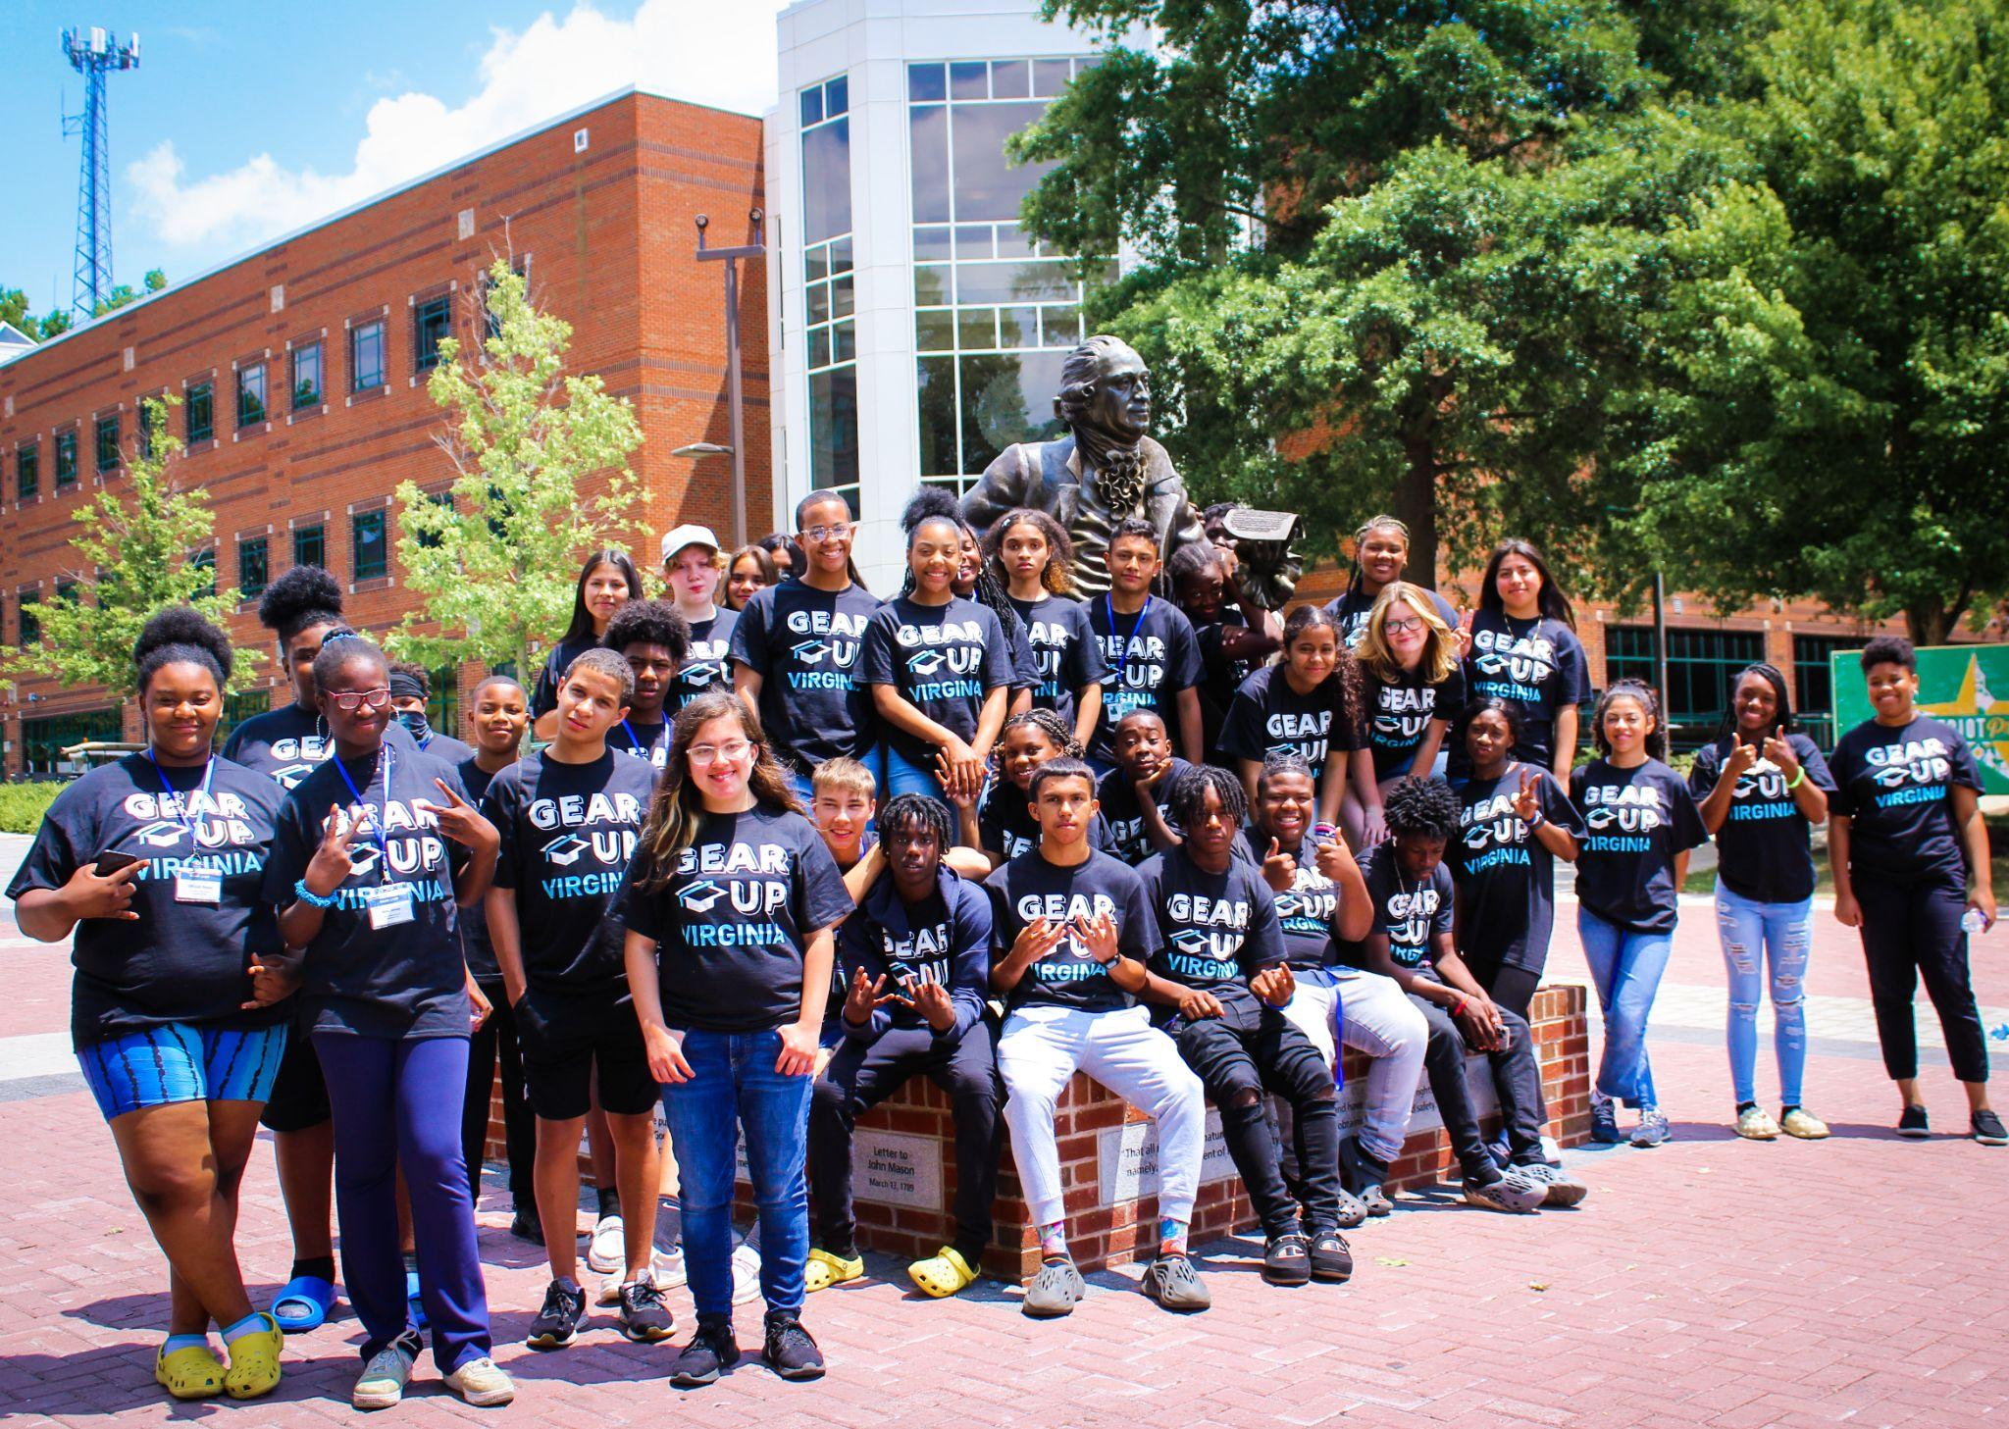
Why GEAR UP Virginia?
In the 2014-2021 GEAR UP Virginia cohort 3, students were:​
Much more likely to enroll in DE & AP classes (+18 percentage compared to other Virginia students)​
Much more likely to graduate with Advanced Diploma (+11 percentage points compared to other Virginia students)​
Much less likely to be chronically absent (-10 percentage points compared to other Virginia students)

Slide 9
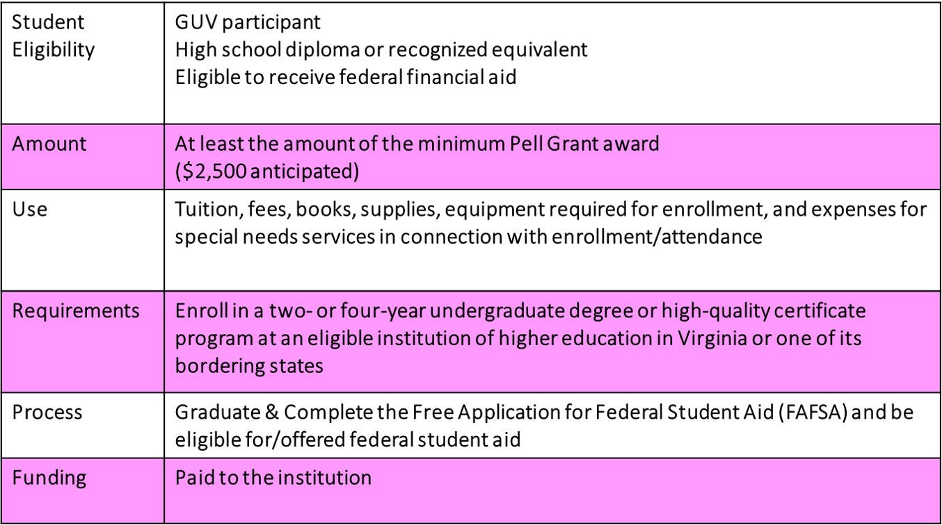
GEAR UP VA Scholarship

Slide 10
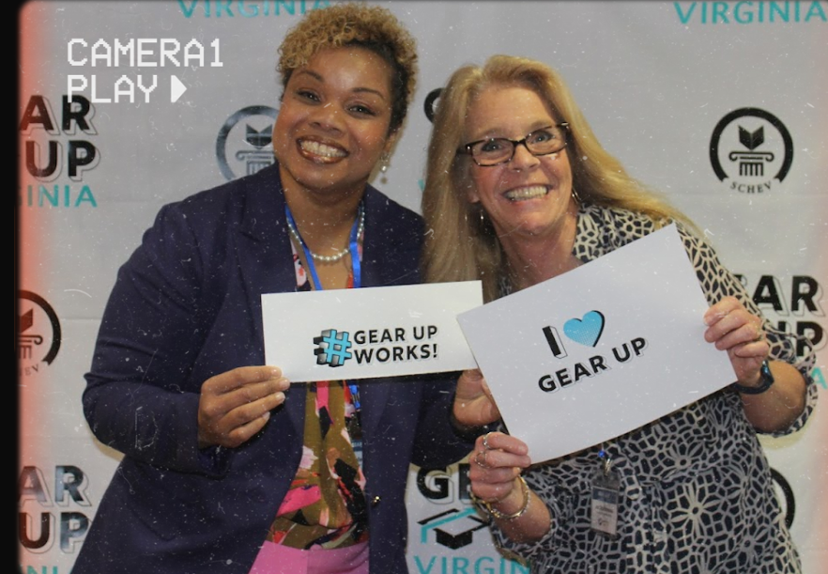
GEAR UP Team
Regional Manager – SCHEV based​
Central Office Liaison ​
Fiscal Officers ​
School Team Leader/Administrator​
GUV Site Coordinator* ​
GUV Data Coordinator*​
GUV Family Liaison*​
*Receive stipends

Slide 11
GEAR UP at [enter school name here]
[List and discuss your school-specific GUV activities, plans, format, contact info, etc.] ​
[Plans listed here can come directly from your I-plan]​
[Try to include any activities or events that staff can support; spirit weeks, college fairs, field trips, tutoring opportunities]

Slide 12
What is Expected of STAFF?
Help your students develop good study habits​
Find ways to connect your subject to a post-secondary opportunity for students to explore​
Connect with your Gear Up Team to see how you can support them​
Volunteer for Gear Up activities and events​
Communicate needs and accomplishments of the cohort to parents and students​
Believe in your school’s Gear Up program!

Slide 13
QUESTIONS?

Slide 14
Stay in Touch!
[School Contact Name]
[​School Contact Email]
[school Contact Phone Number]
Facebook: [your school’s GUV facebook or @gearupvirgina] Instagram: [your school’s GUV instagram or @gearupvirgina] Website: gearupva.org​
[add your school’s black and white GUV logo here. You can find this on the GUV Site Coordinator webpage]

