Slide 1
Family and Community Partners
[coordinators name and title]
[add your school’s black and white GUV logo here. You can find this on the GUV Site Coordinator webpage]

Slide 2
What is GEAR UP?
Acronym: Gaining Early Awareness and Readiness for Undergraduate Programs​
Structure: a competitive grant program funded by the U.S. Dept. Of Education​
Mission: to increase the number of low-income students who are prepared to enter and succeed in postsecondary education programs. ​

Slide 3
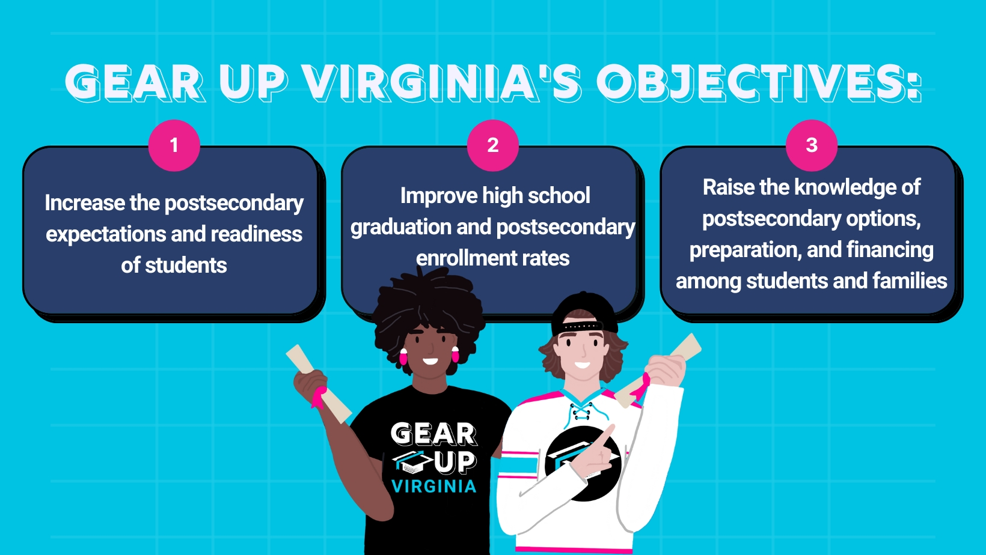

Slide 4
Who GEAR UP Serves:
Students​
Class of 2027 cohort; 11th and ​
12th grade (priority) students​
​
Parents​
Parents and family members​ of GEAR UP students
Educators​
Administrators, counselors and ​
Teachers serving GEAR UP students​
​
Community​
Communities surrounding GEAR ​
UP schools

Slide 5
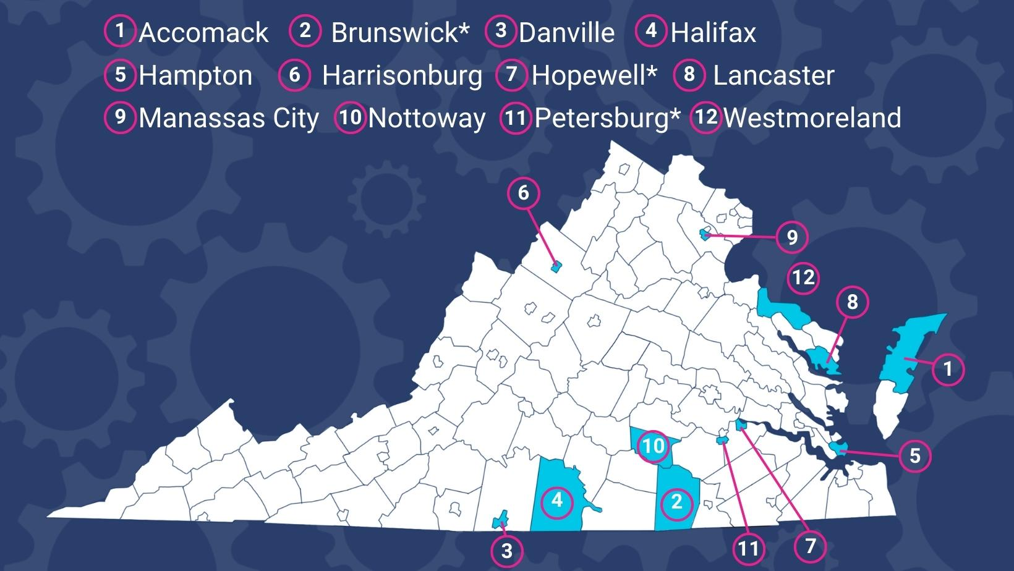
Who GEAR UP Serves:

Slide 6
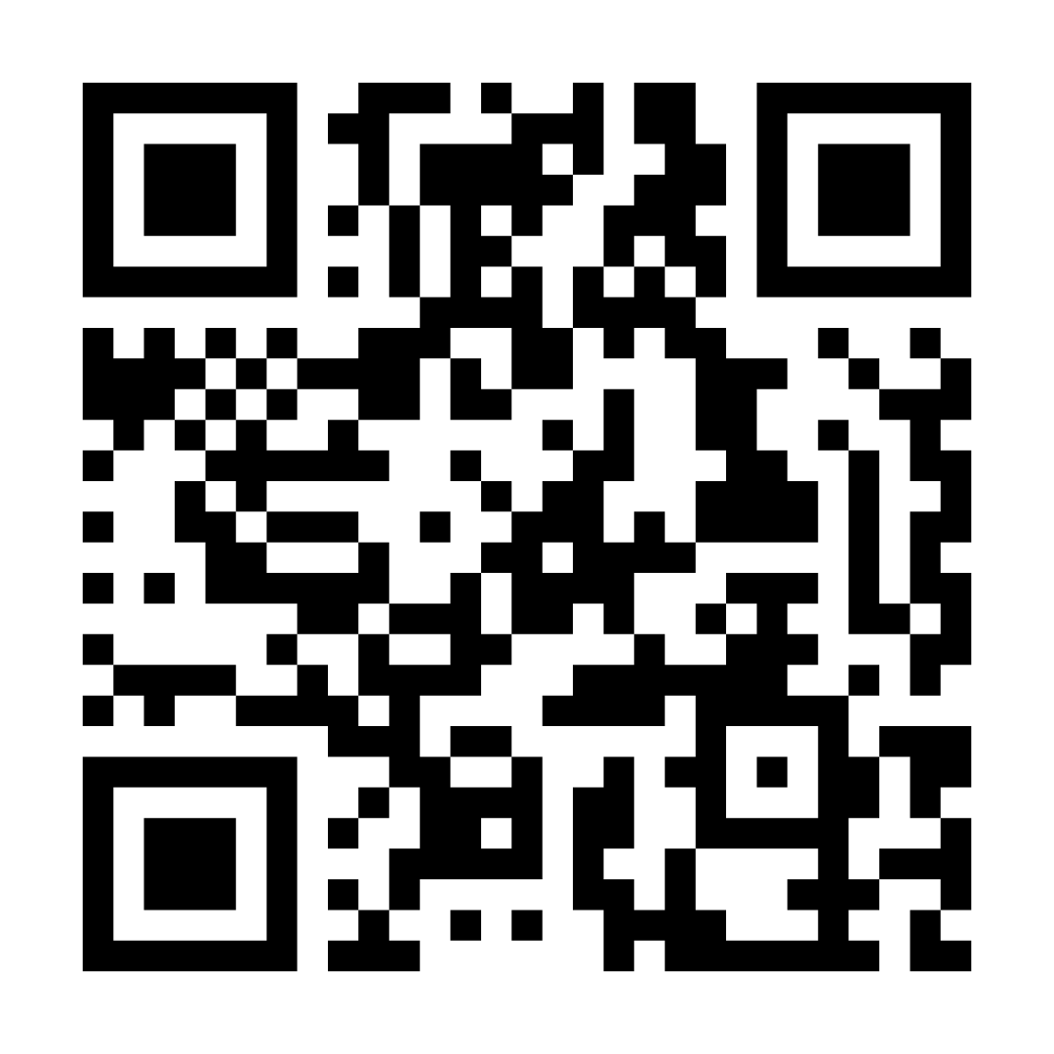
Statewide Initiatives: Level Up Virginia
Can serve any public middle or high school in Virginia with 50% or more free/reduced price lunch through statewide initiatives ​
Level Up Virginia events​
Professional development​
www.levelupvirginia.org

Slide 7
Activities and Services
Tutoring and mentoring​
Summer programs to support transition to high school and, later, transition to college​
College and financial aid awareness workshops for students and families​
College visits​
Career and college counseling
Opportunities for rigorous coursework​
Outreach to help high school graduates as they transition to postsecondary education​
A $2,500 scholarship for eligible GUV students upon high school graduation​
​

Slide 8
GEAR UP at [Your School’s Name]
[add a picture here!]

Slide 9
How Can You Support Our GUV Program?
Serve as a mentor or tutor​
​
Speak to students about careers​
​
Participate in Career/College Day​
​
Speak at family night events ​
​
Donate goods or services
Provide job shadowing opportunities for the students​
Provide internship opportunities for the students​
Serve as a chaperone for college trips

Slide 10
Stay in Touch!
[School Contact Name]
[​School Contact Email]
[school Contact Phone Number]
Facebook: [your school’s GUV facebook or @gearupvirgina] Instagram: [your school’s GUV instagram or @gearupvirgina] Website: gearupva.org​
[add your school’s black and white GUV logo here. You can find this on the GUV Site Coordinator webpage]

