Slide 1

GEARing UP At
[insert school name]
[coordinators name and title]
[add your school’s black and white GUV logo here. You can find this on the GUV Site Coordinator webpage]

Slide 2

WHAT IS GEAR UP?
Gaining​
Early​
Awareness and ​
Readiness for​
Undergraduate ​
Programs
U.S. Department of Education federal grant program designed to significantly increase the number of students who are prepared to enter and succeed in postsecondary education.

Slide 3
Who GEAR UP Serves:
Students​
Class of 2027 cohort; 11th and ​
12th grade (priority) students​
​
Parents​
Parents and family members​ of GEAR UP students
Educators​
Administrators, counselors and ​
Teachers serving GEAR UP students​
​
Community​
Communities surrounding GEAR ​
UP schools

Slide 4
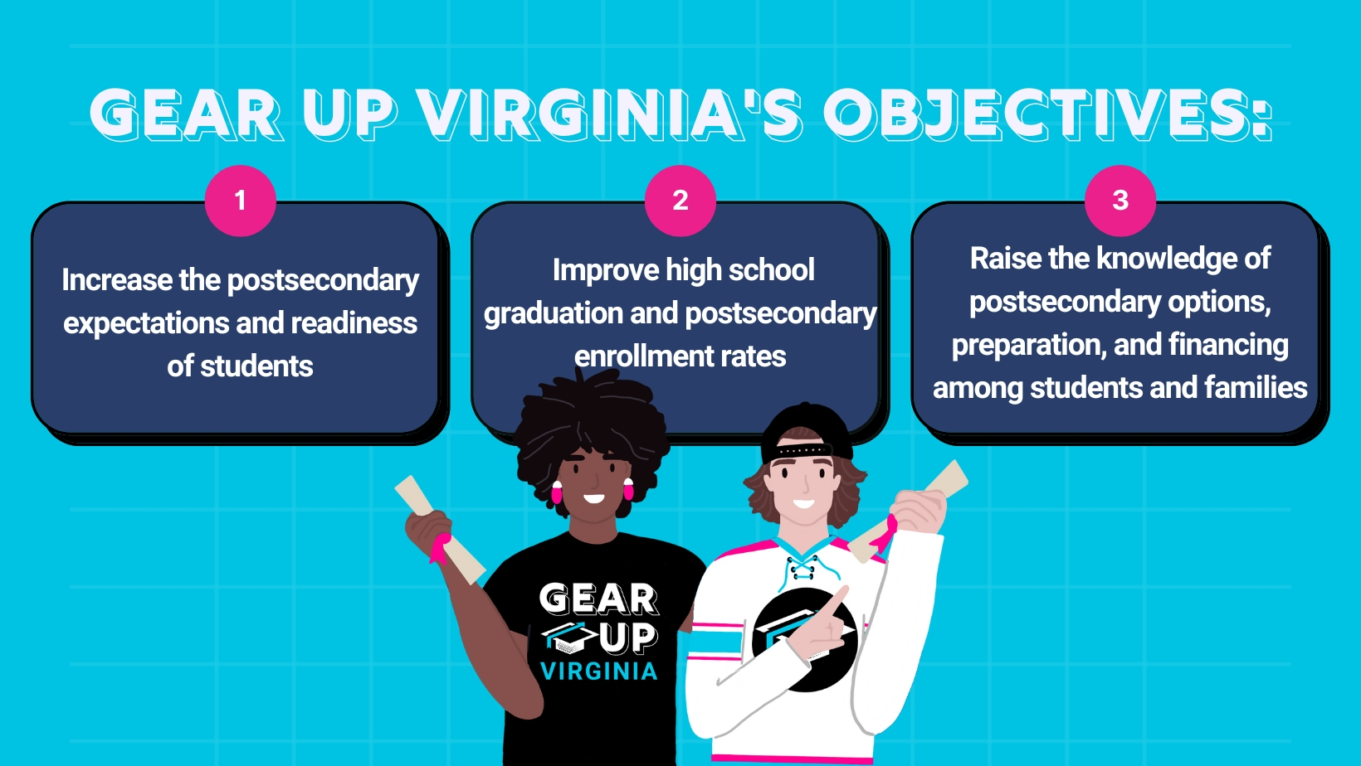

Slide 5
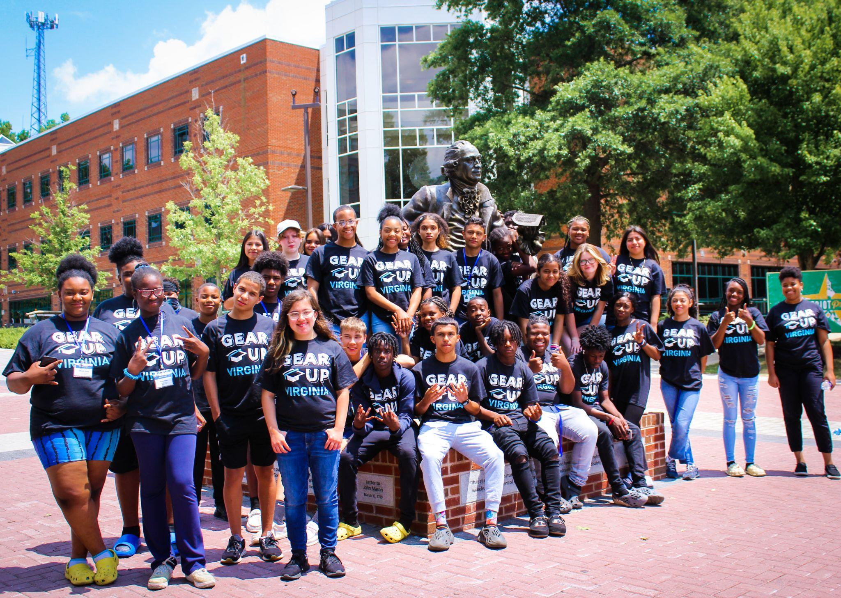
SAMPLE INTERESTS AND SKILLS
In the 2014-2021 GEAR UP Virginia cohort 3, students were:​
Much more likely to enroll in DE & AP classes (+18 percentage compared to other Virginia students)​
Much more likely to graduate with Advanced Diploma (+11 percentage points compared to other Virginia students)​
Much less likely to be chronically absent (-10 percentage points compared to other Virginia students)

Slide 6
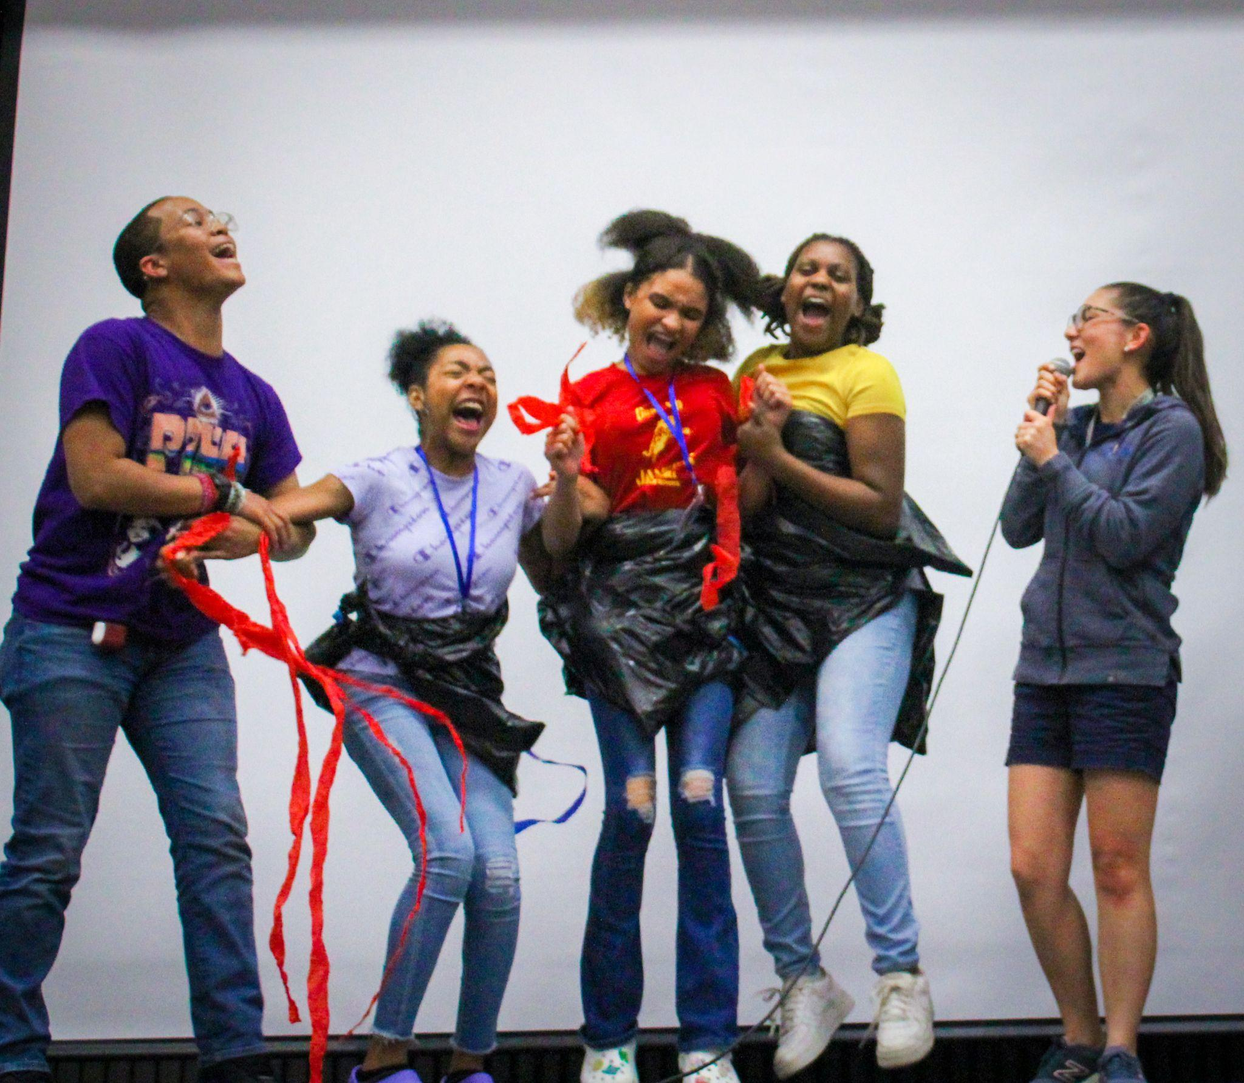
How Does This Impact Your Child?
Access to resources and opportunities connected to college exposure and experiences​
College Trips​
Additional Tutoring and Academic support​
Summer Camps​
Career Planning​
Financial Aid Assistance​
and More!

Slide 7
GEAR UP Virginia Scholarship
Amount : $2,5000​
Use:​
  Tuition, fees, books, supplies, equipment required for enrollment, and expenses for special needs services in connection with enrollment/attendance ​
  Paid to the institution​
Student Eligibility​
  GUV participant​
  High school diploma or recognized equivalent ​
  Enroll in a two- or four-year undergraduate degree or high-quality certificate program at an eligible institution of higher education in Virginia or one of its bordering states​
  Complete the Free Application for Federal Student Aid (FAFSA) and be eligible for/offered federal student aid

Slide 8
GEAR UP at [insert school name here]
[List and discuss your school-specific GUV activities, plans, format, contact info, etc.]

Slide 9
What is Expected of YOU, The Student?
Stay enrolled in school… Attend!​
Do your best and take advantage of presented opportunities, even if they are challenging​
Participate in GEAR UP activities​
Communicate needs, accomplishments and goals ​
Prepare for life after high school (now)​
Apply to postsecondary institution(s)​
Complete the FAFSA (or VASA Application, if applicable) ​
Believe in yourself!

Slide 10
What is Expected of YOU, The Parent?
Help your student develop good homework habits​
Help your student learn how to manage stress and recognize stress triggers ​
Help your student learn to think long-term​
Help your student develop interests and take on challenges​
Help your student stay focused on completion ​
Help your student become independent and self-reliant​
Communicate needs, accomplishments and goals ​
Believe in your child!

Slide 11
Opt-Out Form
GEAR UP will follow the performance and progress of GEAR UP participants through their first year post secondary education.​
Student information will be used for: ​
tracking program goals​
reporting outcomes ​
designing program support services​
The Opt-Out form is available upon request if you wish for your student to not participate in the GEAR UP program. ​
IMPORTANT: Families who decide to opt out will be opting out of all GEAR UP services including the scholarship.

Slide 12
QUESTIONS?

Slide 13
THANK YOU!
[School Contact Name]
[​School Contact Email]
[school Contact Phone Number]
Facebook: [your school’s GUV facebook or @gearupvirgina] Instagram: [your school’s GUV instagram or @gearupvirgina] Website: gearupva.org​
[add your school’s black and white GUV logo here. You can find this on the GUV Site Coordinator webpage]

